Slide 1



ECOMANIA X
By TECH TITANS
Gamifying Environmental Education

Slide 2





What Makes EcoMania X Unique
Daily Eco-Challenges
Interactive Lessons
Bite-sized, actionable tasks that users can complete daily to make a difference.
Engaging quizzes and educational modules embedded within the gameplay.
School Competitions
Digital Badges & Leaderboards
Foster healthy rivalry and teamwork among students and educational institutions.
Instant recognition and progress tracking to keep players motivated.
Our core features are meticulously crafted to blend education with entertainment,
ensuring lasting engagement.
02

Slide 3
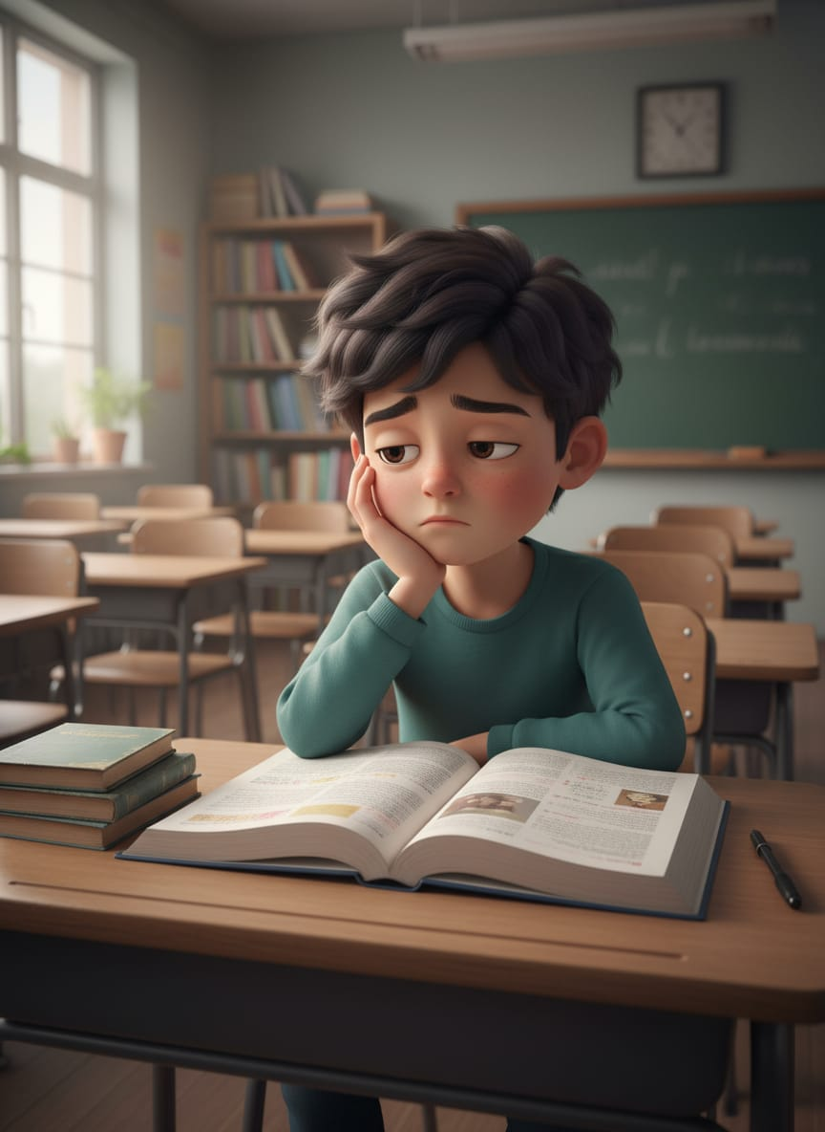
Why This Project ?
Traditional Classroom
Mostly theoretical, textbook-based learning
Lacks real-world relevance and engagement
Students unaware of personal impact
The Need for Change
Passive learning leads to apathy
Disconnected from daily life and actions
Missed opportunities for positive change
03

Slide 4
EcoMania X – Gamifying Sustainability for the Next Generation
A platform to inspire, engage, and reward eco-action . An interactive web-based environmental education platform designed for schools and colleges to engage students in sustainability learning through gamification, challenges, and community competition. Combines education with action through a gamified approach that motivates students to learn about environmental issues while taking concrete steps to make a positive environmental impact in their communities. This platform transforms environmental education from passive learning into an engaging, competitive, and measurable experience that drives both knowledge acquisition and real-world environmental action.
04

Slide 5

Core Functionality: A Glimpse into EcoMania X
DASHBOARD
GAMES
LEARN
DISEASE RECOGNIZER
CHALLENGES
PROFILE
05

Slide 6
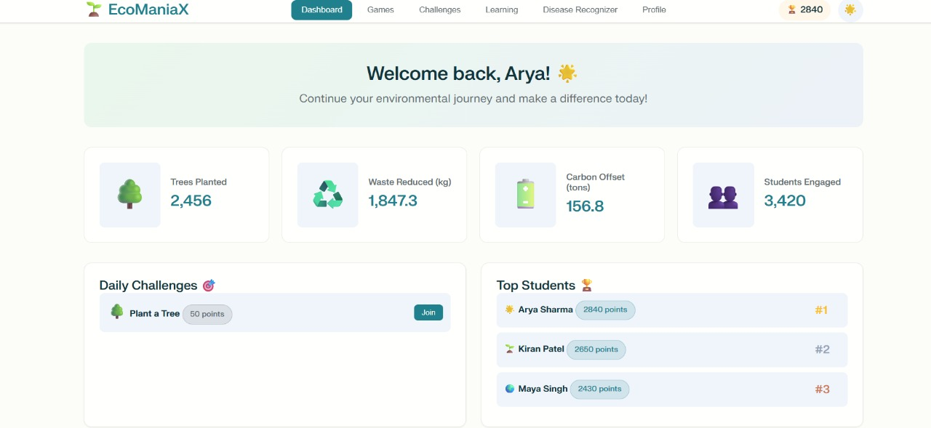
EcoDashboard: Your Central Hub for Impact
Personalized Progress
Track your individual journey with user profiles, avatars, and real-time stats on trees planted and waste reused.
Community Impact
See the collective power! Monitor community-wide carbon offset
percentages and total engaged students.
Daily Engagement
Stay motivated with dynamic daily eco-challenges and an interactive
Eco Points tracker.
Friendly Competition
Ascend the leaderboard and celebrate achievements with the top users.
06

Slide 7

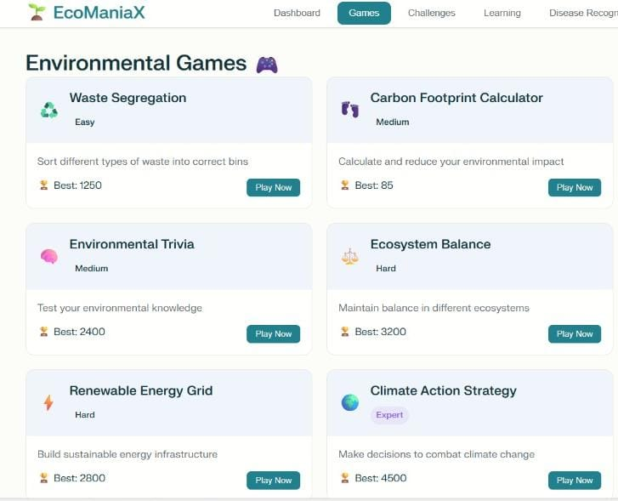



EcoGames Arena: Learn Through Play
Easy: Waste Segregation Sorter
Master the basics of recycling and waste management in a fun,
quick game.
Medium: Carbon Footprint Calculator
Understand your environmental impact by making choices that
affect your virtual carbon footprint.
Hard: Virtual Tree Plantation Simulator
Experience the intricacies of ecosystem restoration and tree
planting in a detailed simulation.
Expert: Climate Crisis Strategy Game
Tackle complex global climate issues, making strategic decisions
to avert environmental disaster.
07

Slide 8


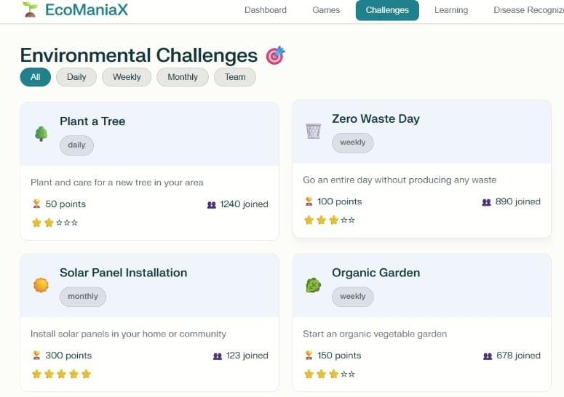



EcoChallenges Hub: Real-World Action, Real Impact
Diverse Missions
Engage in daily, weekly, or monthly missions designed to foster sustainable habits.
Collaborative Efforts
Join team challenges like planting trees, organizing beach cleanups, or starting organic gardens.
Verified Impact
Prove your participation with photo uploads and location tagging for a robust verification system.
Meaningful Rewards
Earn points and exclusive rewards for every completed challenge, reinforcing positive behavior.
08

Slide 9
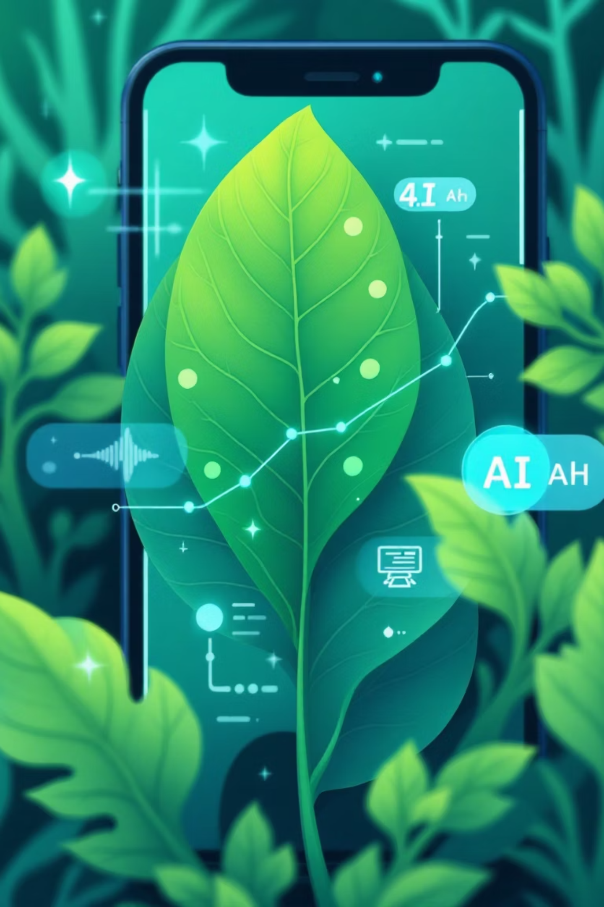



Plant Disease Recognizer: AI for Healthy Flora
Effortless Diagnosis
Simply upload a photo of your plant for instant AI-powered disease detection.
Detailed Disease Insight
Get comprehensive information on detected diseases, including symptoms and causes.
Effective Remedies
Receive suggested organic and chemical solutions tailored to your plant's needs.
09

Slide 10
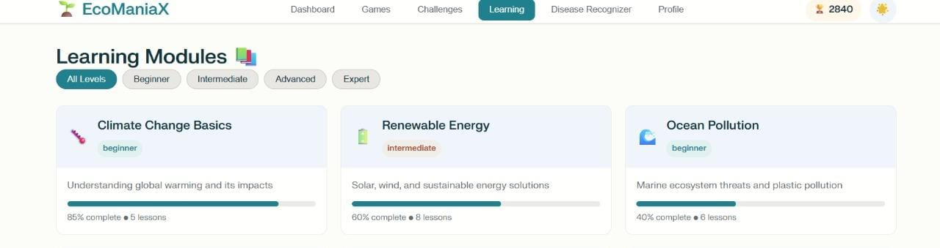
Learn & Earn: Knowledge for a Better Planet
Engaging Video Modules
Interactive Quizzes
Explore critical environmental topics through bite-sized, digestible video content.
Test your knowledge and earn Eco Points with fun, interactive quizzes after each module.
Completion Badges
Personalized Learning Paths
Collect badges for mastering new topics, celebrating your learning milestones.
Experience an adaptive curriculum that adjusts to your learning style and progress.
10

Slide 11




Revenue Model
: Eco-Education E-Learning Platform
Licensing with Institutions
Paid Certifications
Partner with schools, colleges & universities for platform access via annual licensing agreements.
Offer tiered certification programs on environmental topics to learners seeking credentials.
Organic Product Promotion
Monthly Memberships
Integrate eco-friendly product marketplace; earn via affiliate links, sponsorships, and curated listings.
Provide premium access to exclusive content, webinars, and community features through subscription plans.
Scalable & Sustainable: Multi-stream model ensures long-term viability, institutional trust,
and investor appeal.
11

Slide 12





How Students Play & Learn ?
The intuitive gameplay flow of EcoMania X guides students through a rewarding journey of environmental action.
Complete Task
Choose Challenge
Earn Eco-Points
Unlock Rewards
This continuous loop ensures constant motivation and habit formation,
reinforcing positive environmental behaviors.
12

Slide 13








Motivating Sustainable Habits
Digital Badges
EcoPoints
Recognize milestones and skill acquisition, celebrating player achievements.
Awarded for verified completion of eco-actions and challenges.
Unlock Rewards
School Leaderboards
In-game and real-world incentives for sustained engagement and impact.
Showcase top eco-champions and foster friendly competition among peers and schools.
Our robust reward system is designed to sustain motivation, transforming sporadic actions into ingrained, sustainable habits.
13

Slide 14
Meet the Minds Behind the Mission
👥 Team Members
Gursimarjot Singh – (Team Leader), Front-End Developer
Jatin Gupta – Front-End Developer
Nishika Sehgal – Back-End Developer
Prachita – Back-End Developer
Mayank – Presentation Designer
Team Tech Titans
14

Slide 15
Thank You!
Thank you for your time and consideration.
We’re grateful to every mentor, judge, and fellow hacker who supported our journey.
Your feedback, encouragement, and energy helped us turn a vision into a platform
that empowers students to become eco-champions .
15

